Slide 1
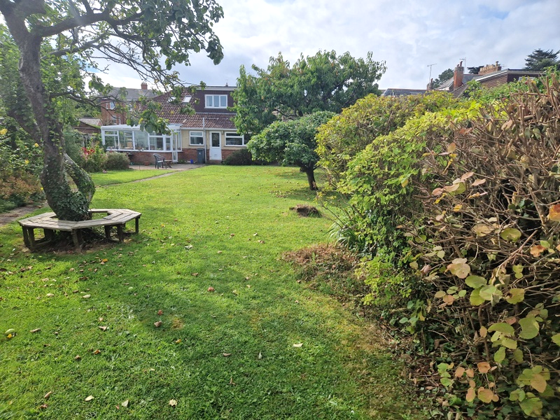
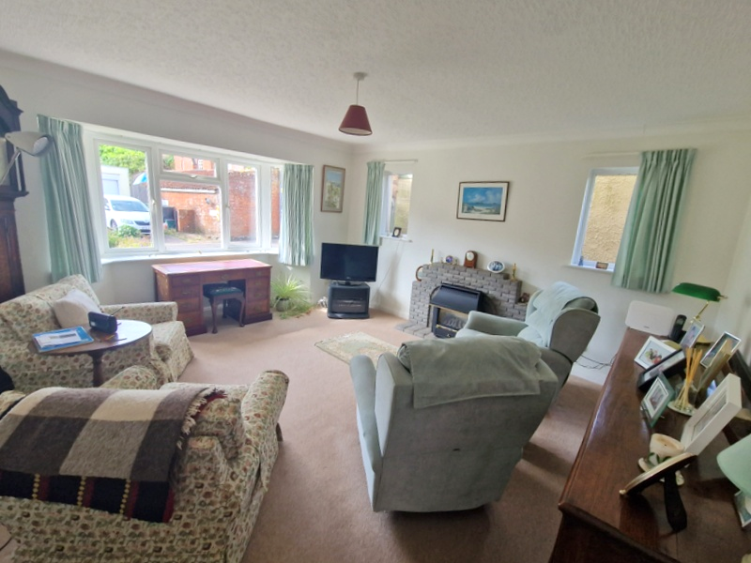
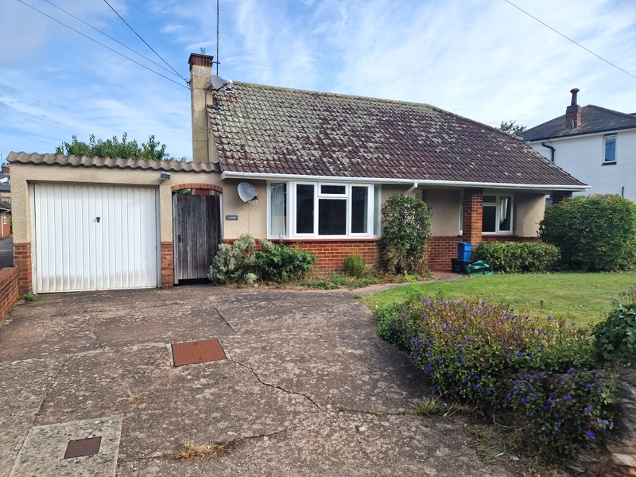
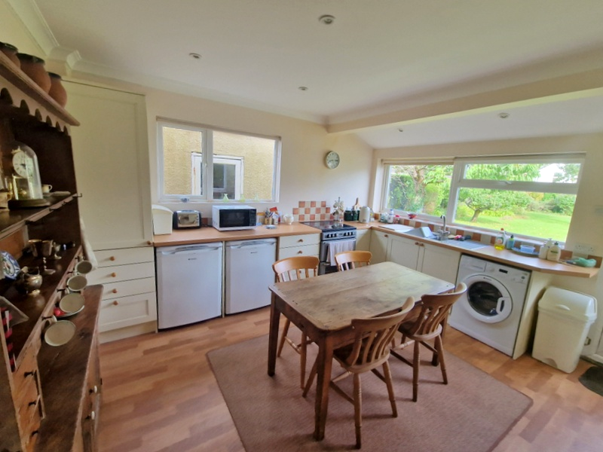
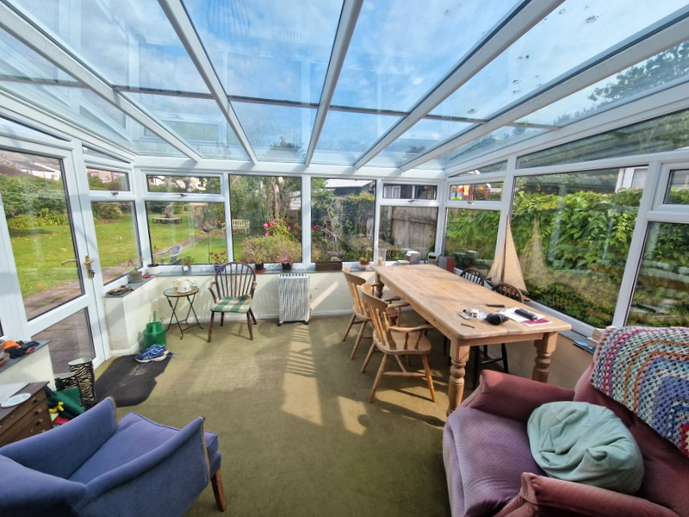
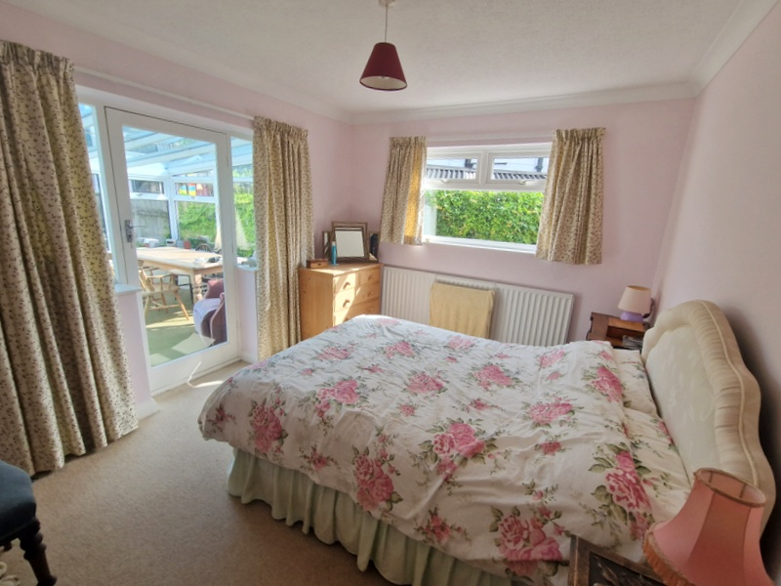
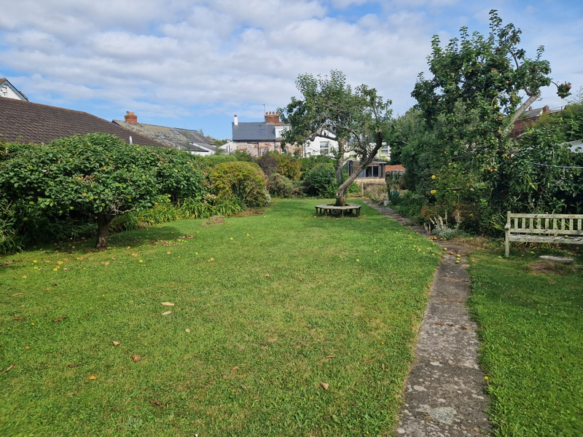
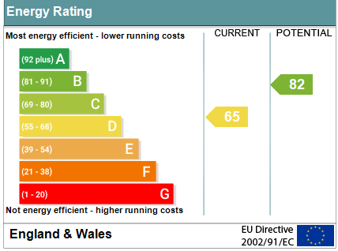
www.pennys.net
Alfayda, Underhill, Lympstone, Exmouth, EX8 5HH
GUIDE PRICE £750,000
TENURE Freehold
A Rare Opportunity To Purchase A Detached Chalet Style Bungalow Enjoying A Central Village Setting With Extensive Gardens, Drive And Large Garage
Lounge * Kitchen/Dining Room * Two Ground Floor Bedrooms * Modern Ground Floor Bath/Shower Room/Wc * Two Further First Floor Bedrooms – One With En-Suite Bath/Shower Room/Wc * Gas Central Heating * Double Glazed Windows * No Ongoing Chain * Viewing Recommended
Pennys Estate Agents Limited for themselves and for the vendor of this property whose agents they are give notice that:- (1) These particulars do not constitute any part of an offer or a contract. (2) All statements contained in these particulars are made without responsibility on the part of Pennys Estate Agents Limited. (3) None of the statements contained in these particulars are to be relied upon as a statement or representation of fact. (4) Any intending purchaser must satisfy himself/herself by inspection or otherwise as to the correctness of each of the statements contained in these particulars. (5) The vendor does not make or give and neither do Pennys Estate Agents Limited nor any person in their employment has any authority to make or give any representation or warranty whatever in relation to this property.
PENNYS ESTATE AGENTS
2 Rolle House, Rolle Street, Exmouth, Devon, EX8 2SN
Tel: 01395 264111 EMail: help@pennys.net

Slide 2
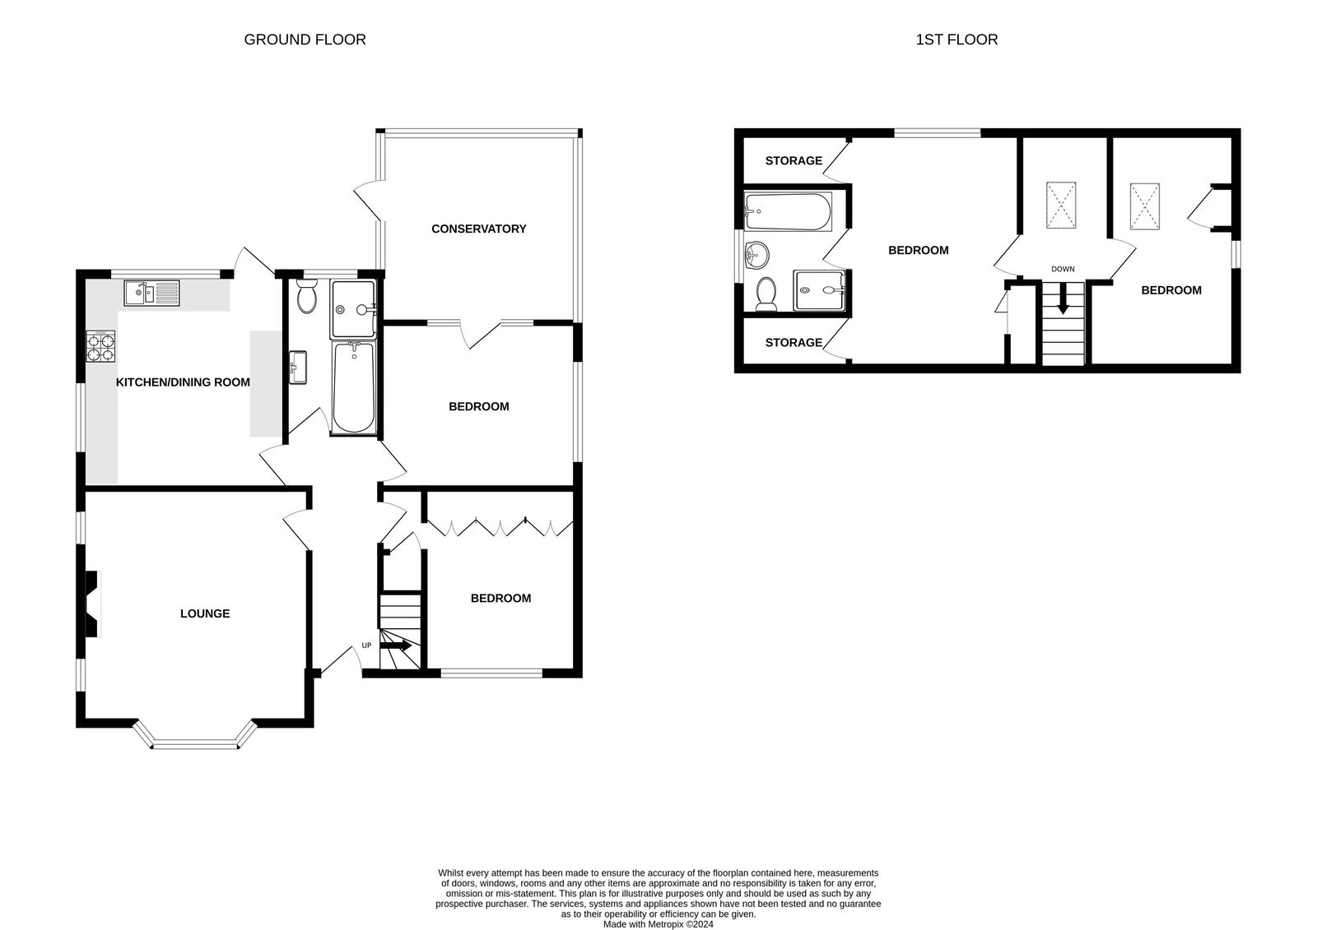
Alfayda, Underhill, Lympstone, Exmouth, EX8 5HH
Pennys are delighted to offer for sale a wonderfully situated and deceptively spacious detached chalet style property in the heart of the sought-after village of Lympstone. The property is offered for sale with no ongoing chain and enjoys four bedrooms arranged on the ground and first floors with two bathroom suites, conservatory extension and large spacious kitchen/dining room. Outside there are wonderful gardens, a large garage and driveway parking. Viewing is strongly recommended.
Lympstone is a highly regarded village in the favoured Exe Estuary with an excellent range of local facilities including a sailing club, three pubs, village hall, general store, post office, primary and pre-schools as well as an independent preparatory school. There is a railway station connecting to Exeter. Nearby is the Exe Estuary Trail, the National Cycle path and walkway which runs around Exe Estuary linking Exmouth, Exeter and Dawlish. The centre of Exeter is 8.5 miles whilst junction 30 of the M5 motorway is 6 miles.
THE ACCOMMODATION COMPRISES: Open pillared entrance porch with courtesy light, uPVC front door with double glazed patterned window inset to:
RECEPTION HALL: Radiator, stairs rising to first floor.
LOUNGE: 4.85m x 4.24m (15'11" x 13'11") With measurement into uPVC double glazed bay window which overlooks the front aspect with two further uPVC double glazed windows to the side aspect. Feature brick fire surround with matching hearth housing living flame gas fire, TV point, radiator.
KITCHEN/DINING ROOM: 4.01m x 3.81m (13'2" x 12'6") A bright spacious room with two sets of uPVC double glazed windows to side and rear aspects, fitted with wood effect worktops with cupboards, drawer units, plumbing for automatic washing machine and appliance spaces beneath, inset one and a half bowl single drainer sink unit with mixer tap in tiled surrounds, wall mounted cupboards and upright larder style cupboards (one housing electric consumer unit), gas cooker point, radiator, two radiators, recessed led ceiling spotlighting, uPVC door giving access to the rear garden.
GROUND FLOOR BEDROOM: 3.71m x 3.02m (12'2" x 9'11") uPVC double glazed window to side aspect, radiator, windows and glazed door to:
CONSERVATORY: 3.61m x 3.56m (11'10" x 11'8") A fine addition to the accommodation with uPVC double glazed windows and door overlooking and giving access to the rear garden, TV point, power and light connected, upright radiator.
GROUND FLOOR BEDROOM: 3.66m x 3.58m (12'0" x 11'9") maximum overall measurement. Built-in wardrobes and understairs storage cupboard, radiator, uPVC double glazed window to front and side aspects.
GROUND FLOOR BATH/SHOWER ROOM/WC: 2.95m x 1.73m (9'8" x 5'8") Stylish modern suite comprising bath, shower cubicle, vanity style wash hand basin with mirror fronted medicine cabinet over, WC with push button flush, chrome heated towel rail, attractive extensively tiled walls, recessed ceiling led spotlighting, uPVC double glazed window with patterned glass.
FIRST FLOOR LANDING: With double glazed velux window, radiator, doors to:
FIRST FLOOR BEDROOM: 4.37m x 3.02m (14'4" x 9'11") With built-in wardrobe and access to boarded eaves storage space, two accesses to boarded roof space, radiator, uPVC double glazed window overlooking the rear aspect, recessed ceiling spotlighting.
EN-SUITE BATH/SHOWER ROOM/WC: 2.44m x 2.01m (8'0" x 6'7") Comprising bath with shower attachment, shower cubicle with Mira shower unit and sliding shower splash screen, pedestal wash hand basin, WC with push button flush, chrome heated towel rail, extensively tiled walls, recessed ceiling spotlighting, ceiling extractor fan, uPVC double glazed window with patterned glass.
BEDROOM: 5.44m x 2.51m (17'10" x 8'3") maximum measurement into wall recess. With double glazed velux window and further uPVC double glazed window to side aspect, cupboard housing Vaillant gas boiler for hot water and central heating, radiator.
OUTSIDE: Adjoining enviable village centre location, the property is approached by a driveway leading to an attached GARAGE, with lawned front garden edged with shrub beds, side gate and pathway gives access through to the rear garden. The rear garden is a wonderful feature of the property being generous in size, extensively laid to lawn with mature flower and shrub beds, a variety of trees, cherry trees and apple trees, patio sun terrace, pathway extending the length of the garden, timber store, greenhouse, two outside cold water tap. To the rear of the garage is an outside WC. Outside lighting.
GARAGE: 8.79m x 2.64m (28'10" x 8'8") widening to 3.45m (11'4") With window and door. The garage is a larger than average garage. Power and light connected.
FLOOR PLAN:

